Slide 1


Muhammad Anwar
13/02/2024

Slide 2

Outline
Executive Summary
Introduction
Methodology
Results
Conclusion
Appendix

Slide 3
Executive Summary
The data was collected data from public SpaceX API and SpaceX Wikipedia page. The cleaning of the data was done. The labels column ‘class’ which classifies successful landings created.
The data was explored using SQL, visualization tools, folium maps, and dashboards.
The relevant columns were gathered to use them as features. The categorical variables were changed to binary. The Standardized data and GridSearchCV were used to find best parameters for machine learning models. The accuracy score of all models was investigated.

Slide 4
Executive Summary
We used four machine learning models including Logistic Regression, Support Vector Machine, Decision Tree Classifier, and K Nearest Neighbors.
All models produced similar results with accuracy rate of about 83.33%. All models over predicted successful landings. More data is needed for better model determination and accuracy.

Slide 5
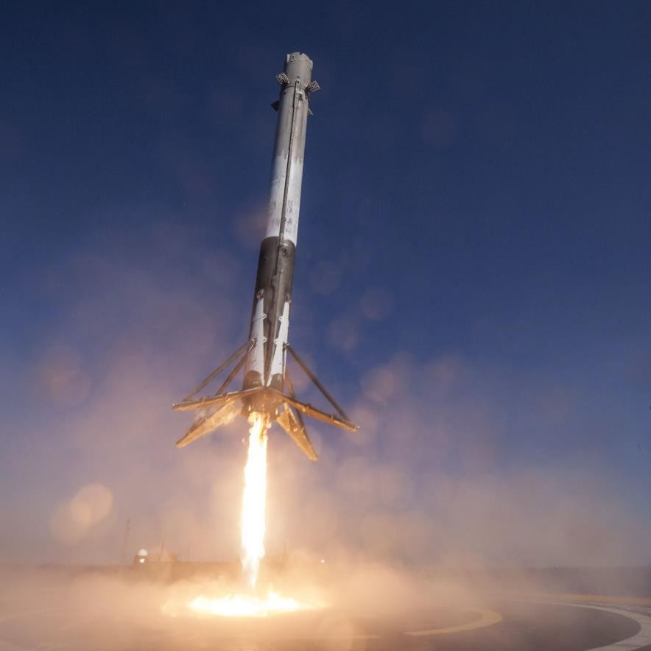
Introduction
Background
Commercial Space Age is Here
Space X has best pricing ($62 million vs. $165 million USD)
Largely due to ability to recover part of rocket (Stage 1)
Space Y wants to compete with Space X
Problem
Space Y tasks us to train a machine learning model to predict successful Stage 1 recovery
SpaceX Falcon 9 Rocket – The Verge

Slide 6

Section 1

Slide 7
Methodology
Data collection methodology:
Combined data from SpaceX public API and SpaceX Wikipedia page
Perform data wrangling
Classifying true landings as successful and unsuccessful otherwise
Perform exploratory data analysis (EDA) using visualization and SQL
Perform interactive visual analytics using Folium and Plotly Dash
Perform predictive analysis using classification models
Tuned models using GridSearchCV

Slide 8
Data Collection
Data collection process involved a combination of API requests from Space X API and web scraping data from a table in Space X’s Wikipedia entry.
Space X API Data Columns:
FlightNumber, Date, BoosterVersion, PayloadMass, Orbit, LaunchSite, Outcome, Flights, GridFins,
Reused, Legs, LandingPad, Block, ReusedCount, Serial, Longitude, Latitude
Wikipedia Webscrape Data Columns:
Flight No., Launch site, Payload, PayloadMass, Orbit, Customer, Launch outcome, Version Booster, Booster landing, Date, Time

Slide 9

Data Collection – SpaceX API
Request (Space X APIs)
Filter data to only include Falcon 9 launches
Imputate missing PayloadMass values with mean
.JSON file + Lists(Launch Site, Booster Version, Payload Data)
Cast dictionary to a DataFrame
Json_normalize to DataFrame data from JSON
Dictionary relevant data
URL link:
https://github.com/manwar18/Applied-Data-Science-Capstone/blob/main/Data%20Collection%20with%20API%20Lab%20.ipynb

Slide 10
Data Collection – Web Scraping
Request Wikipedia
html
Cast dictionary to DataFrame
Iterate through table cells to extract data to dictionary
BeautifulSoup
html5lib Parser
URL link:
https://github.com/manwar18/Applied-Data-Science-Capstone/blob/main/Data%20Collection%20with%20Web%20Scraping%20Lab.ipynb
Find launch info html table
Create dictionary
10

Slide 11
Data Wrangling
Create a training label with landing outcomes where successful = 1 & failure = 0.
Outcome column has two components: ‘Mission Outcome’ ‘Landing Location’
New training label column ‘class’ with a value of 1 if ‘Mission Outcome’ is True and 0 otherwise.
Value Mapping:
True ASDS, True RTLS, & True Ocean – set to -> 1
None None, False ASDS, None ASDS, False Ocean, False RTLS – set to -> 0
GitHub URL:
https://github.com/manwar18/Applied-Data-Science-Capstone/blob/main/Data%20Wrangling%20Lab.ipynb

Slide 12
EDA with Data Visualization
Exploratory Data Analysis performed on variables Flight Number, Payload Mass, Launch Site, Orbit, Class and Year.
Plots Used:
Flight Number vs. Payload Mass, Flight Number vs. Launch Site, Payload Mass vs. Launch Site, Orbit vs. Success Rate, Flight Number vs. Orbit, Payload vs Orbit, and Success Yearly Trend
Scatter plots, line charts, and bar plots were used to compare relationships between variables to
decide if a relationship exists so that they could be used in training the machine learning model
GitHub URL:
https://github.com/manwar18/Applied-Data-Science-Capstone/blob/main/EDA%20with%20Visualization%20Lab.ipynb

Slide 13
EDA with SQL
Loaded data set into IBM DB2 Database.
Queried using SQL Python integration.
Queries were made to get a better understanding of the dataset.
Queried information about launch site names, mission outcomes, various pay load sizes of customers and booster versions, and landing outcomes
GitHub URL:
https://github.com/manwar18/Applied-Data-Science-Capstone/blob/main/EDA%20with%20SQL-checkpoint%20Lab.ipynb

Slide 14
Build an Interactive Map with Folium
Folium maps mark Launch Sites, successful and unsuccessful landings, and a proximity example to key locations: Railway, Highway, Coast, and City.
This allows us to understand why launch sites may be located where they are. Also visualizes successful landings relative to location.
GitHub URL:
https://github.com/manwar18/Applied-Data-Science-Capstone/blob/main/Interactive%20Visual%20Analytics%20with%20Folium%20Lab.ipynb

Slide 15
Build a Dashboard with Plotly Dash
Dashboard includes a pie chart and a scatter plot.
Pie chart can be selected to show distribution of successful landings across all launch sites and can be selected to show individual launch site success rates.
Scatter plot takes two inputs: All sites or individual site and payload mass on a slider between 0 and 10000 kg.
The pie chart is used to visualize launch site success rate.
The scatter plot can help us see how success varies across launch sites, payload mass, and booster version category.
GitHub URL:
https://github.com/manwar18/Applied-Data-Science-Capstone/blob/main/spacex_dash_app.py

Slide 16
Predictive Analysis (Classification)
Split label column
Score models on
Confusion Matrix
‘Class’ from dataset
split test set
for all models
Fit and Transform
Use GridSearchCV
Features using
on LogReg, SVM,
Barplot to compare scores of models
Standard Scaler
Decision Tree, and
KNN models
GridSearchCV
GitHub URL:
https://github.com/manwar18/Applied-Data-Science-Capstone/blob/main/Machine%20Learning%20Prediction%20Lab.ipynb
Train_test_split
(cv=10) to find optimal parameters
data

Slide 17
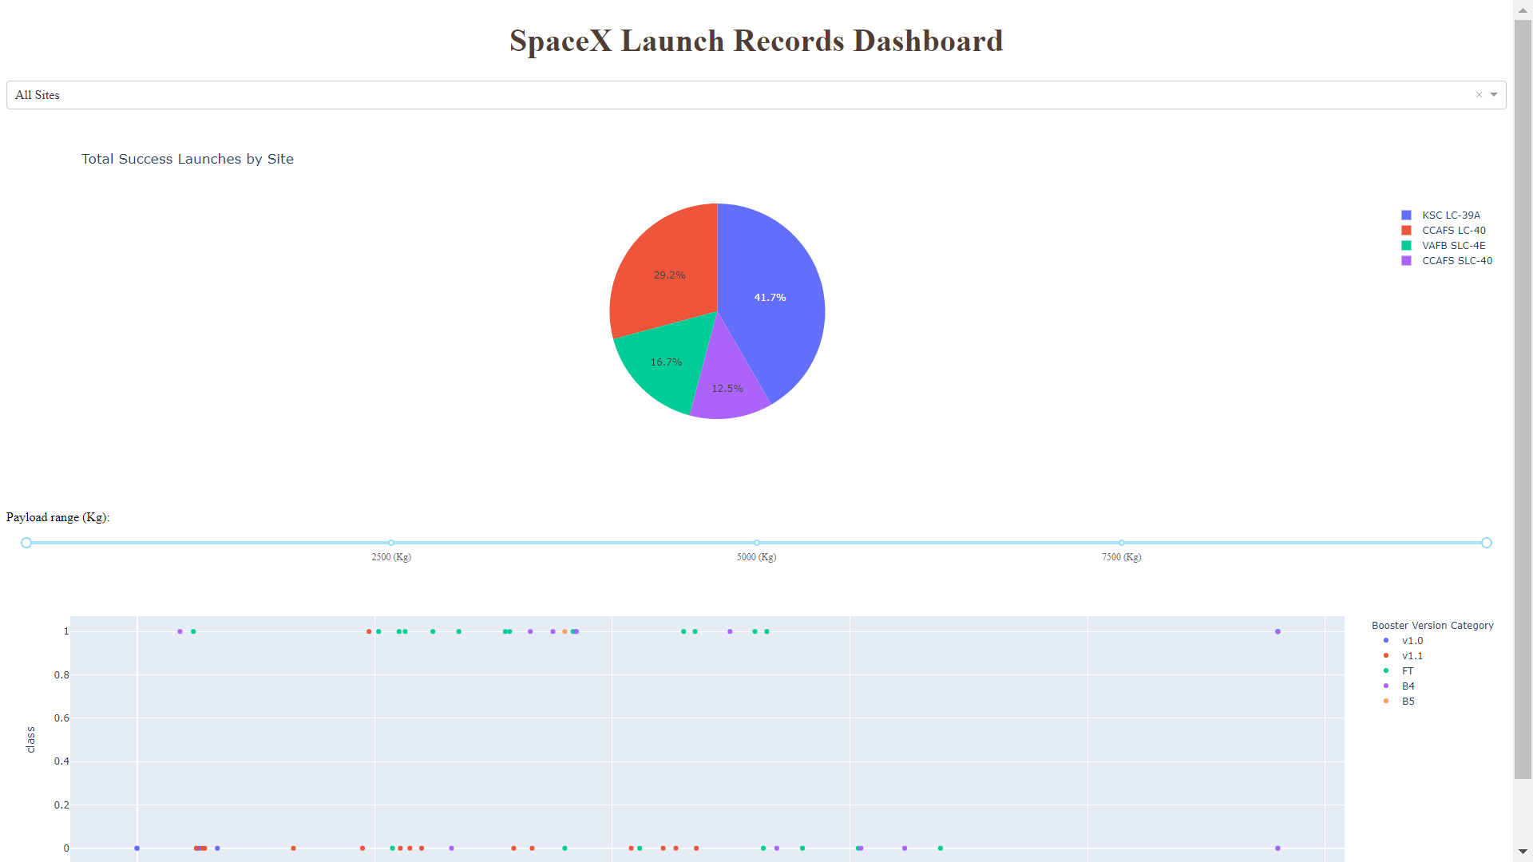
Results
This is a preview of the Plotly dashboard. The following sides will show the results of EDA with visualization, EDA with SQL, Interactive Map with Folium, and finally the results of our model with about 83% accuracy.

Slide 18

Section 2

Slide 19
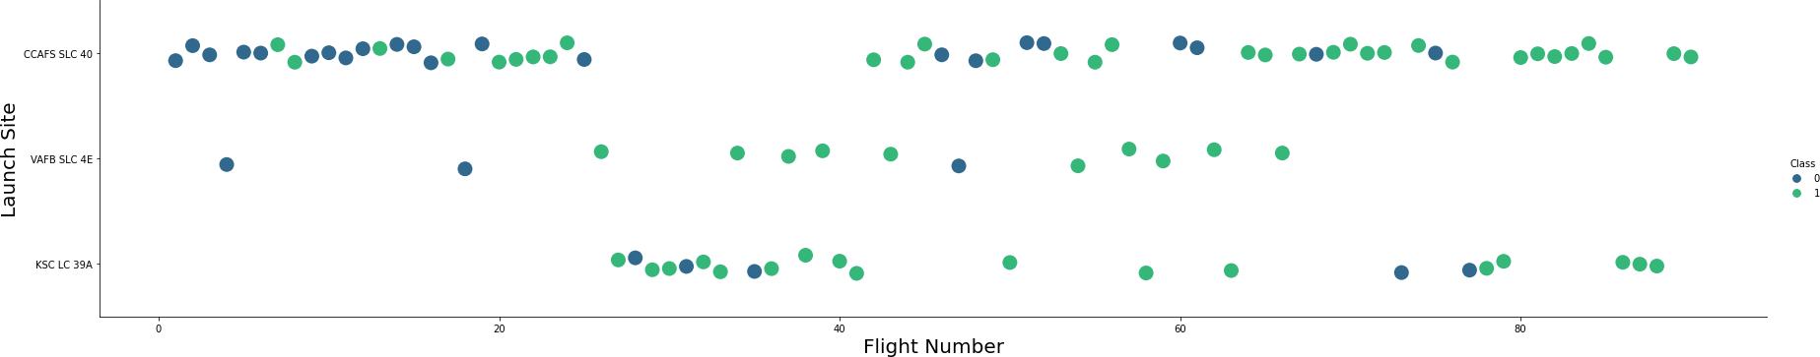
Flight Number vs. Launch Site
* Green circles indicate successful launch; Blue circles indicate unsuccessful launch.
Graphic suggests an increase in success rate over time (indicated in Flight Number). Likely a big breakthrough around flight 20 which significantly increased success rate. CCAFS appears to be the main launch site as it has the most volume.

Slide 20
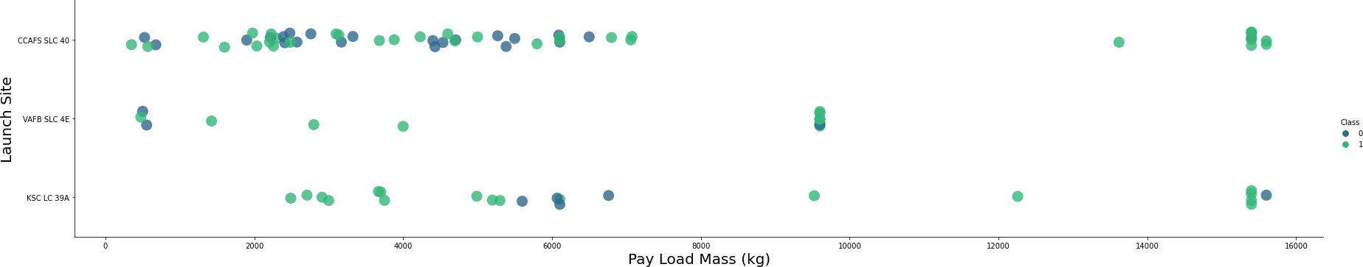
Payload vs. Launch Site
Green circles indicates successful launch; Blue circles indicate unsuccessful launch.
Payload mass appears to fall mostly between 0-6000 kg. Different launch sites also seem to use different payload mass.

Slide 21
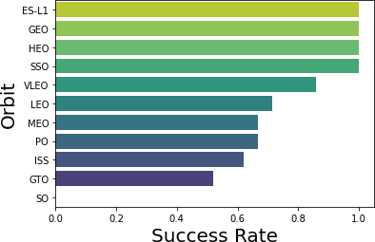
Success Rate vs. Orbit Type
Success Rate Scale with 0 as 0%
0.6 as 60% 1 as 100%
ES-L1 (1), GEO (1), HEO (1) have 100% success rate (sample sizes in parenthesis) SSO (5) has 100% success rate
VLEO (14) has decent success rate and attempts
SO (1) has 0% success rate
GTO (27) has the around 50% success rate but largest sample

Slide 22
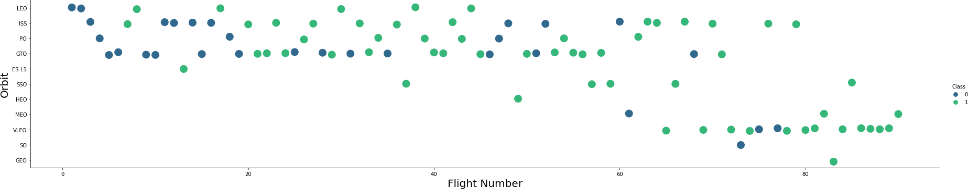
Flight Number vs. Orbit Type
Green circles indicate successful launch; Blue circles indicates unsuccessful launch.
Launch Orbit preferences changed over Flight Number. Launch Outcome seems to correlate with this preference.
SpaceX started with LEO orbits which saw moderate success LEO and returned to VLEO in recent launches SpaceX appears to perform better in lower orbits or Sun-synchronous orbits

Slide 23
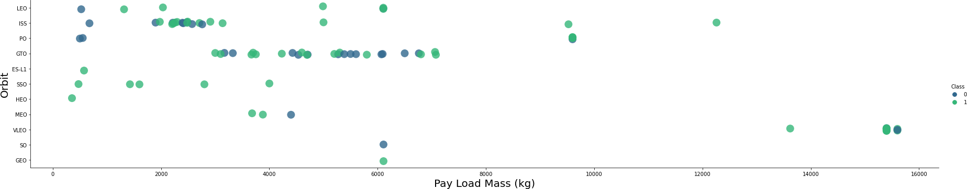
Payload vs. Orbit Type
Green circles indicate successful launch; Blue circles indicate unsuccessful launch.
Payload mass seems to correlate with orbit
LEO and SSO seem to have relatively low payload mass
The other most successful orbit VLEO only has payload mass values in the higher end of the range

Slide 24
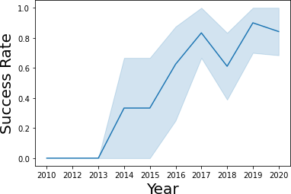
Launch Success Yearly Trend
95% confidence interval (light blue shading)
Success generally increases over time since 2013 with a slight dip in 2018
Success in recent years at around 80%

Slide 25
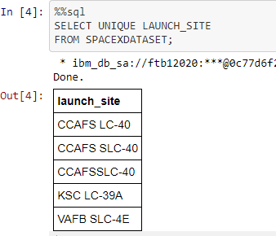
All Launch Site Names
Query unique launch site names from database.
CCAFS SLC-40 and CCAFSSLC-40 likely all represent the same
launch site with data entry errors.
CCAFS LC-40 was the previous name. Likely only 3 unique launch_site values: CCAFS SLC-40, KSC LC-39A, VAFB SLC-4E

Slide 26

Launch Site Names Begin with 'CCA'
First five entries in database with Launch Site name beginning with CCA.

Slide 27

Total Payload Mass
This query sums the total payload mass in kg where NASA was the customer.
CRS stands for Commercial Resupply Services which indicates that these payloads were sent to the International Space Station (ISS).

Slide 28
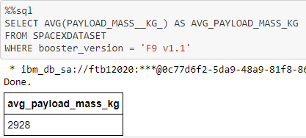
Average Payload Mass by F9 v1.1
This query calculates the average payload mass or launches which used booster version F9 v1.1
Average payload mass of F9 1.1 is on the low end of our payload mass range

Slide 29

First Successful Ground Landing Date
This query returns the first successful ground pad landing date.
First ground pad landing wasn’t
until the end of 2015.
SuccesAsful landings in general
appear starting 2014.

Slide 30

Successful Drone Ship Landing with Payload between 4000 and 6000
This query returns the four booster versions that had successful drone ship landings and a payload mass between 4000 and 6000 noninclusively.

Slide 31
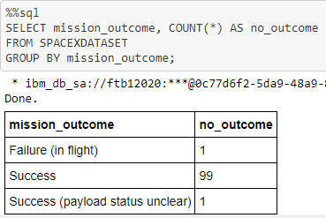
Total Number of Successful and Failure Mission Outcomes
This query returns a count of each mission outcome.
SpaceX appears to achieve its mission outcome nearly 99% of the time.
This means that most of the landing failures are intended.
Interestingly, one launch has an unclear payload status and unfortunately one failed in flight.

Slide 32
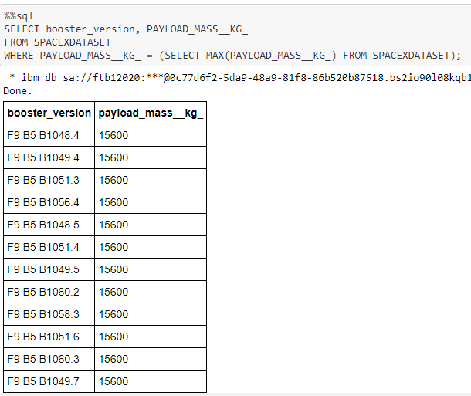
Boosters Carried Maximum Payload
This query returns the booster versions that carried the highest payload mass of 15600 kg.
These booster versions are very similar and all are of the F9 B5 B10xx.x variety.
This likely indicates payload mass correlates with the booster version that is used.

Slide 33
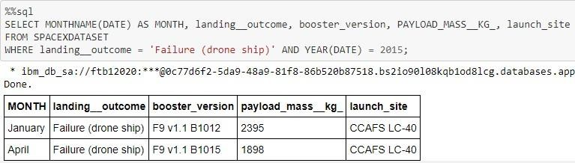
2015 Launch Records
This query returns the Month, Landing Outcome, Booster Version, Payload Mass (kg), and Launch site of 2015 launches where stage 1 failed to land on a drone ship.
There were two such occurrences.

Slide 34
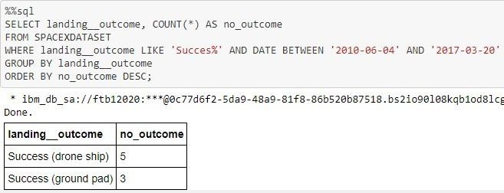
Rank Landing Outcomes Between 2010-06-04 and 2017-03-20
This query returns a list of successful landings and between 2010-06-04 and 2017-03-20 inclusively.
There are two types of successful landing outcomes: drone ship and ground pad landings.
There were 8 successful landings in total during this time period

Slide 35

Section 3

Slide 36

Launch Site Locations
The left map shows all launch sites relative US map. The right map shows the two Florida launch sites since they are very close to each other. All launch sites are near the ocean.

Slide 37

Color-Coded Launch Markers
Clusters on Folium map can be clicked on to display each successful landing (green icon) and failed landing (red icon). In this example VAFB SLC-4E shows 4 successful landings and 6 failed landings.

Slide 38



Key Location Proximities
Using KSC LC-39A as an example, launch sites are very close to railways for large part and supply transportation. Launch sites are close to highways for human and supply transport. Launch sites are also close to coasts and relatively far from cities so that launch failures can land in the sea to avoid rockets falling on densely populated areas.

Slide 39

Section 4

Slide 40
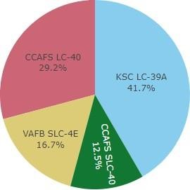
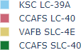
Successful Launches Across Launch Sites
This is the distribution of successful landings across all launch sites. CCAFS LC-40 is the old name of CCAFS SLC-40 so CCAFS and KSC have the same amount of successful landings, but a majority of the successful landings where performed before the name change. VAFB has the smallest share of successful landings. This may be due to smaller sample and increase in difficulty of launching in the west coast.

Slide 41

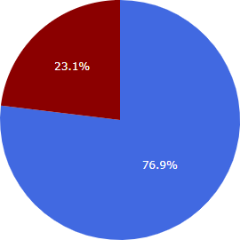
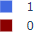
Highest Success Rate Launch Site
KSC LC-39A has the highest success rate with 10 successful landings and 3 failed landings.

Slide 42

Payload Mass vs. Success vs. Booster Version Category
Plotly dashboard has a Payload range selector. However, this is set from 0-10000 instead of the max Payload of 15600. Class indicates 1 for successful landing and 0 for failure. Scatter plot also accounts for booster version category in color and number of launches in point size. In this particular range of 0-6000, interestingly there are two failed landings with payloads of zero kg.

Slide 43

Section 5

Slide 44
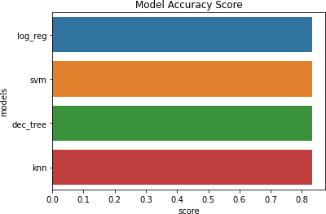
Classification Accuracy
All models had virtually the same accuracy on the test set at 83.33% accuracy. It should be noted that test size is small at only sample size of 18.
This can cause large variance in accuracy results, such as those in Decision Tree Classifier model in repeated runs.
We likely need more data to determine the best model.

Slide 45

Confusion Matrix
Correct predictions are on a diagonal from top left to bottom right.
Since all models performed the same for the test set, the confusion matrix is the same across all models. The models predicted 12 successful landings when the true label was successful landing.
The models predicted 3 unsuccessful landings when the true label was unsuccessful landing.
The models predicted 3 successful landings when the true label was unsuccessful landings (false positives). Our models over predict successful landings.

Slide 46
Conclusions
The main objective is to develop a machine learning model for SpaceY which we want to bid against SpaceX
The goal of model is able to predict when the Stage 1 will successfully land to save ~$100 million USD
We used data from a public SpaceX API and Web Scraping SpaceX Wikipedia page
We created data labels and stored data into a SQL database
We created a dashboard for visualization
We created a machine learning model with an accuracy of 83%
Allon Mask of SpaceY can use this highly accurate model to predict whether a launch will have a successful Stage 1 landing or not. Based on this work, it can be decided either to launch or not
More data should be collected to better determine the best machine learning model and improve accuracy

Slide 47
Appendix
GitHub repository url:
https://github.com/manwar18/Applied-Data-Science-Capstone/tree/main
Instructors:
Rav Ahuja, Alex Aklson, Aije Egwaikhide, Svetlana Levitan, Romeo Kienzler, Polong Lin, Joseph Santarcangelo, Azim Hirjani, Hima Vasudevan, Saishruthi Swaminathan, Saeed Aghabozorgi, Yan Luo

Slide 48


